Slide 1


Slide 2
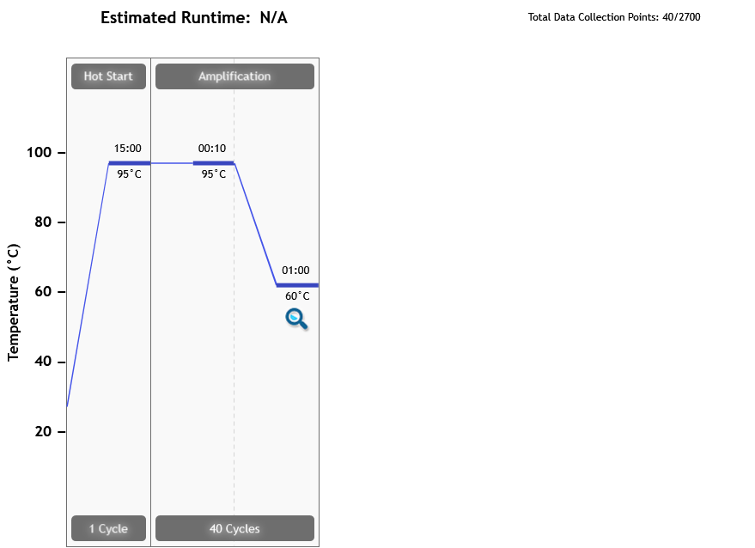
Thermal Profile
Page 2 of 9

Slide 3
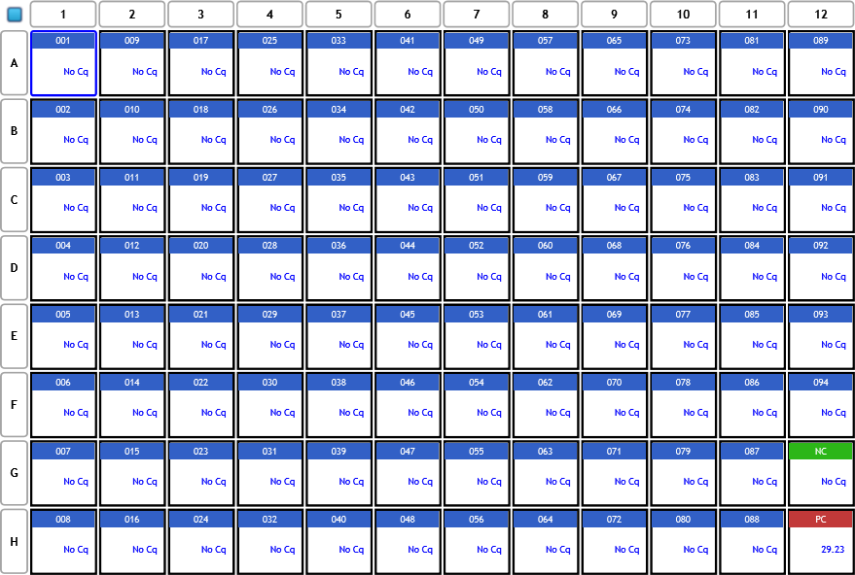
Analysis Criteria
Page 3 of 9

Slide 4
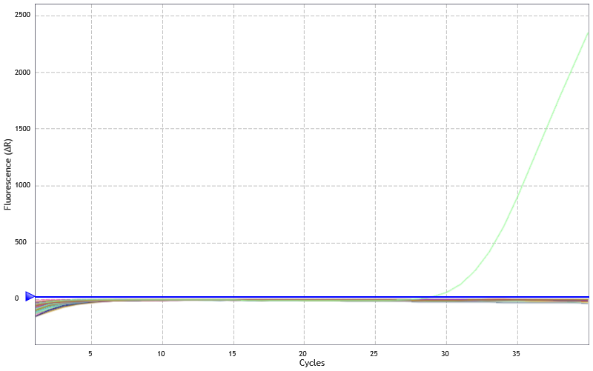
Amplification Plots
Threshold settings based on background: Start cycle = 5, End cycle = 9,
Sigma multiplier = 10, Baseline correction = Adaptive, Smoothing = On,
Crosstalk Correction: -
Page 4 of 9

Slide 5
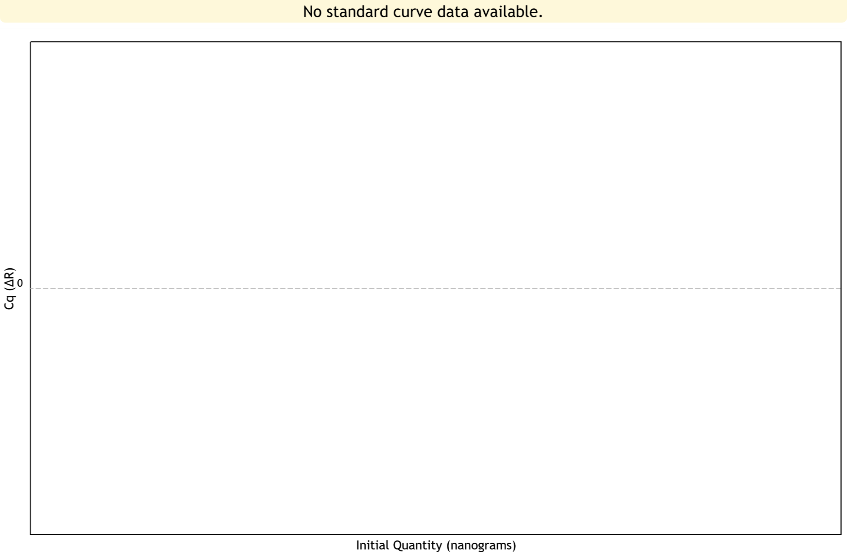
Standard Curve Plots
Confidence Level = Disabled
Page 5 of 9

Slide 6
Tabular Results (1 of 4)
Well | Well Name | Target | Cq (∆R) | Final Call (∆R)
A1 | 001 | vivax | No Cq | -
A2 | 009 | vivax | No Cq | -
A3 | 017 | vivax | No Cq | -
A4 | 025 | vivax | No Cq | -
A5 | 033 | vivax | No Cq | -
A6 | 041 | vivax | No Cq | -
A7 | 049 | vivax | No Cq | -
A8 | 057 | vivax | No Cq | -
A9 | 065 | vivax | No Cq | -
A10 | 073 | vivax | No Cq | -
A11 | 081 | vivax | No Cq | -
A12 | 089 | vivax | No Cq | -
B1 | 002 | vivax | No Cq | -
B2 | 010 | vivax | No Cq | -
B3 | 018 | vivax | No Cq | -
B4 | 026 | vivax | No Cq | -
B5 | 034 | vivax | No Cq | -
B6 | 042 | vivax | No Cq | -
B7 | 050 | vivax | No Cq | -
B8 | 058 | vivax | No Cq | -
B9 | 066 | vivax | No Cq | -
B10 | 074 | vivax | No Cq | -
B11 | 082 | vivax | No Cq | -
B12 | 090 | vivax | No Cq | -
Page 6 of 9

Slide 7
Tabular Results (2 of 4)
Well | Well Name | Target | Cq (∆R) | Final Call (∆R)
C1 | 003 | vivax | No Cq | -
C2 | 011 | vivax | No Cq | -
C3 | 019 | vivax | No Cq | -
C4 | 027 | vivax | No Cq | -
C5 | 035 | vivax | No Cq | -
C6 | 043 | vivax | No Cq | -
C7 | 051 | vivax | No Cq | -
C8 | 059 | vivax | No Cq | -
C9 | 067 | vivax | No Cq | -
C10 | 075 | vivax | No Cq | -
C11 | 083 | vivax | No Cq | -
C12 | 091 | vivax | No Cq | -
D1 | 004 | vivax | No Cq | -
D2 | 012 | vivax | No Cq | -
D3 | 020 | vivax | No Cq | -
D4 | 028 | vivax | No Cq | -
D5 | 036 | vivax | No Cq | -
D6 | 044 | vivax | No Cq | -
D7 | 052 | vivax | No Cq | -
D8 | 060 | vivax | No Cq | -
D9 | 068 | vivax | No Cq | -
D10 | 076 | vivax | No Cq | -
D11 | 084 | vivax | No Cq | -
D12 | 092 | vivax | No Cq | -
Page 7 of 9

Slide 8
Tabular Results (3 of 4)
Well | Well Name | Target | Cq (∆R) | Final Call (∆R)
E1 | 005 | vivax | No Cq | -
E2 | 013 | vivax | No Cq | -
E3 | 021 | vivax | No Cq | -
E4 | 029 | vivax | No Cq | -
E5 | 037 | vivax | No Cq | -
E6 | 045 | vivax | No Cq | -
E7 | 053 | vivax | No Cq | -
E8 | 061 | vivax | No Cq | -
E9 | 069 | vivax | No Cq | -
E10 | 077 | vivax | No Cq | -
E11 | 085 | vivax | No Cq | -
E12 | 093 | vivax | No Cq | -
F1 | 006 | vivax | No Cq | -
F2 | 014 | vivax | No Cq | -
F3 | 022 | vivax | No Cq | -
F4 | 030 | vivax | No Cq | -
F5 | 038 | vivax | No Cq | -
F6 | 046 | vivax | No Cq | -
F7 | 054 | vivax | No Cq | -
F8 | 062 | vivax | No Cq | -
F9 | 070 | vivax | No Cq | -
F10 | 078 | vivax | No Cq | -
F11 | 086 | vivax | No Cq | -
F12 | 094 | vivax | No Cq | -
Page 8 of 9

Slide 9
Tabular Results (4 of 4)
Well | Well Name | Target | Cq (∆R) | Final Call (∆R)
G1 | 007 | vivax | No Cq | -
G2 | 015 | vivax | No Cq | -
G3 | 023 | vivax | No Cq | -
G4 | 031 | vivax | No Cq | -
G5 | 039 | vivax | No Cq | -
G6 | 047 | vivax | No Cq | -
G7 | 055 | vivax | No Cq | -
G8 | 063 | vivax | No Cq | -
G9 | 071 | vivax | No Cq | -
G10 | 079 | vivax | No Cq | -
G11 | 087 | vivax | No Cq | -
G12 | NC | vivax | No Cq | -
H1 | 008 | vivax | No Cq | -
H2 | 016 | vivax | No Cq | -
H3 | 024 | vivax | No Cq | -
H4 | 032 | vivax | No Cq | -
H5 | 040 | vivax | No Cq | -
H6 | 048 | vivax | No Cq | -
H7 | 056 | vivax | No Cq | -
H8 | 064 | vivax | No Cq | -
H9 | 072 | vivax | No Cq | -
H10 | 080 | vivax | No Cq | -
H11 | 088 | vivax | No Cq | -
H12 | PC | vivax | 29.23 | +
Page 9 of 9

